Slide 1

Ho Chi Minh University of Technology
Faculty of Computer Science and Engineering
Computer Engineering Project | 2024
Computer Engineering Project
---oOo---
Acceleration of
Graph Attention Network
on FPGA
Authors:
Hoang Tien Duc - 2152520
Dang Hoang Gia - 2153312
Nguyen Duc Bao Huy - 2152089
Council: CE - CC05
Supervisor: Assoc. Prof. Pham Quoc Cuong
Member Secretary: Mr. Nguyen Thanh Loc
1
Notes:
G morning every one,
This is Gia and our team member Duc Huy
I will present our Computer Engineering project about Acceleration of Graph Attention Network on FPGA.

Slide 2
Outline
Ho Chi Minh University of Technology
Faculty of Computer Science and Engineering
Computer Engineering Project | 2024
01. Introduction
04. Overall Architecture
02. Background
05. Implementation
03. Methodological Approach
06. Result
2

Slide 3
01
Introduction
3

Slide 4
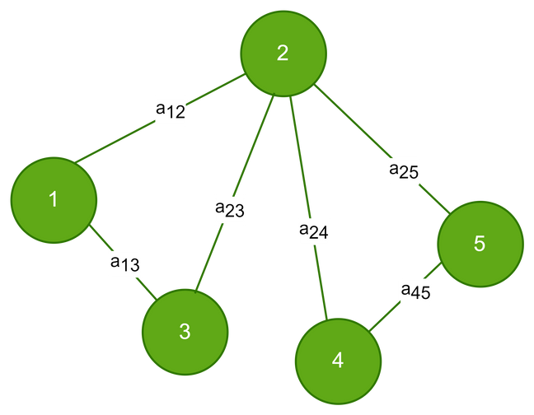
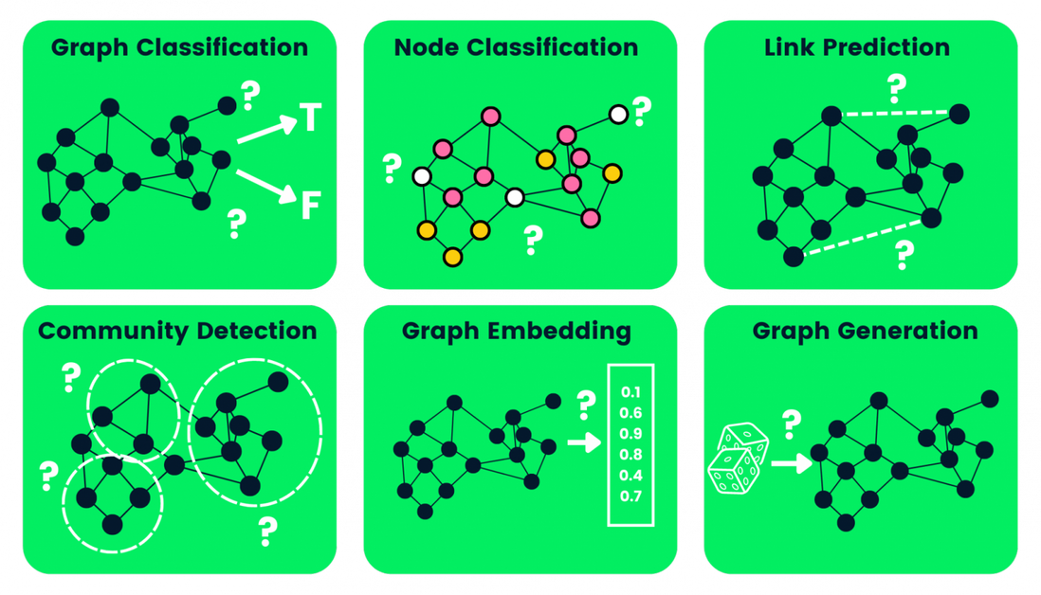
Graph Neural Network
Ho Chi Minh University of Technology
Faculty of Computer Science and Engineering
Computer Engineering Project | 2024
GCN:
Used in tasks like node classification and link prediction
But poor performance on dynamic and inductive tasks.
GAT:
Improves flexibility with an attention mechanism, focusing on important node relationships,
Make it better for complex, dynamic, and real-time tasks.
==> FPGA-based accelerators for GAT are needed to accelerate the computation of GAT operations.
.
4
Notes:
Graph Convolutional Network
or to say Convolutional Network in graph structure
but may result in poor performance in some specific dataset of inductive task.
GRAPH ATTENTION NETWORK

Slide 5
02
Background
5

Slide 6
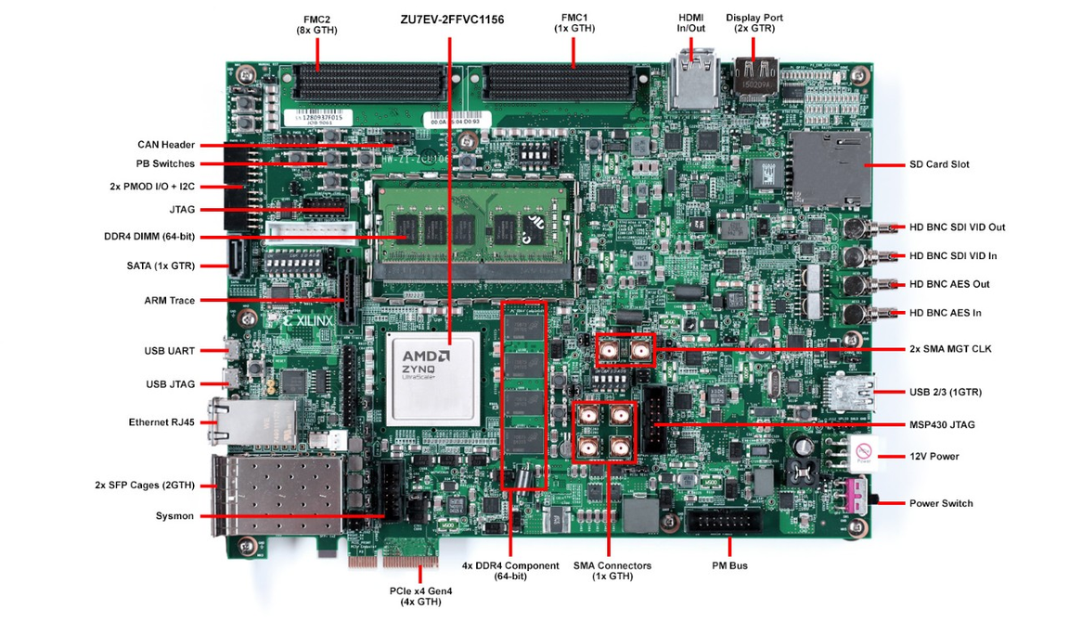
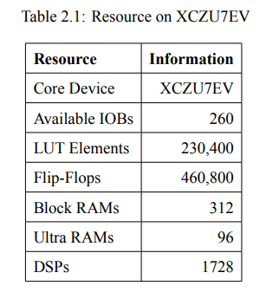
ZCU106 Zynq SoC Ultrascale+
Ho Chi Minh University of Technology
Faculty of Computer Science and Engineering
Computer Engineering Project | 2024
Zynq UltraScale+ MPSoC ZCU106
Resource on XCZU7EV
6
Notes:
our experiment is plan to implemented on ZCU Soc Ultrascale+
with a large resource of LUT and Block RAM

Slide 7
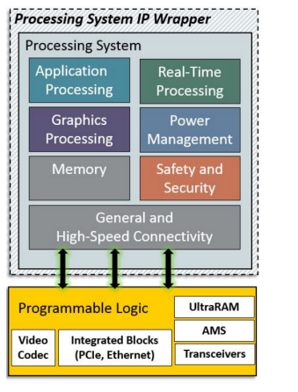
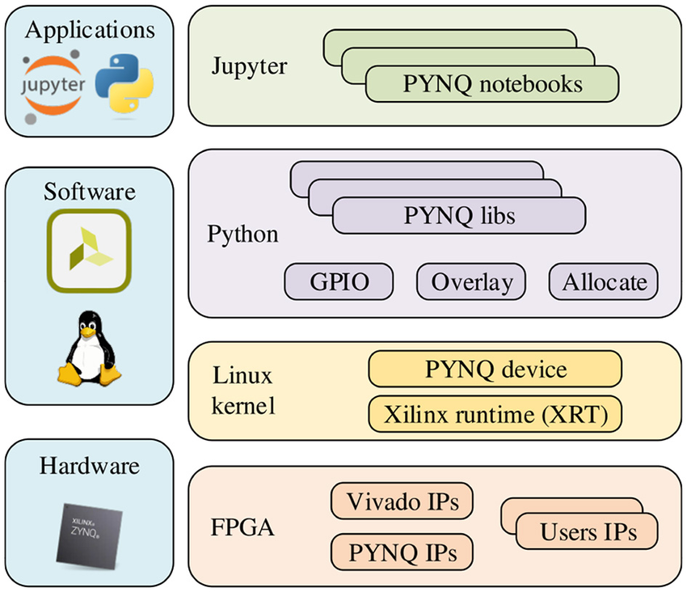
Ho Chi Minh University of Technology
Faculty of Computer Science and Engineering
Computer Engineering Project | 2024
PYNQ Processing System
Pynq Framework
Xilinx PS-PL Connectivity

Slide 8
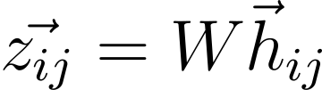
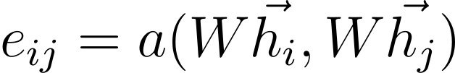
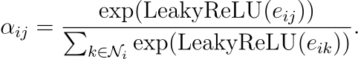
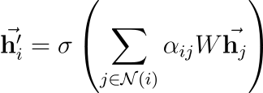
Graph Attention Network
Ho Chi Minh University of Technology
Faculty of Computer Science and Engineering
Computer Engineering Project | 2024
GAT Algorithms:
Linear transformation:
Attention coefficient:
Softmax:
Aggregation:
7
Notes:
We list out 4 formula for a graph attention layer, which are

Slide 9
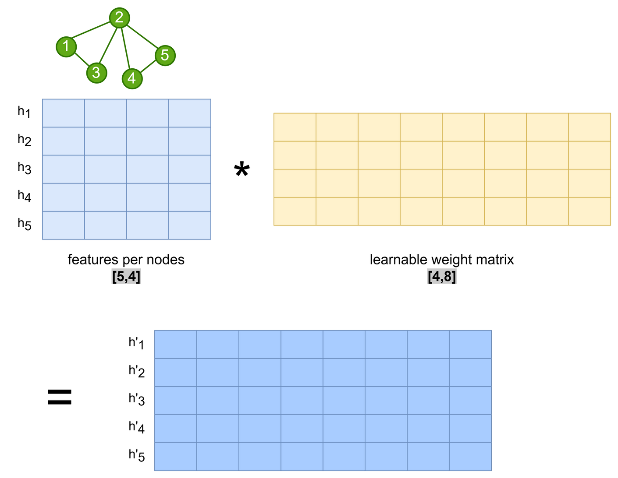
Graph Attention Network
Ho Chi Minh University of Technology
Faculty of Computer Science and Engineering
Computer Engineering Project | 2024
Weight and feature linear transformation
8
Notes:
In the figure, each row of matrix H will be a vector to perform linear transformation with Weight matrix W.
for example in this case, 5 rows of matrix H with 4 features value will multiply with 4x8 W matrix.
the result will be 4 vector z with size 8.

Slide 10
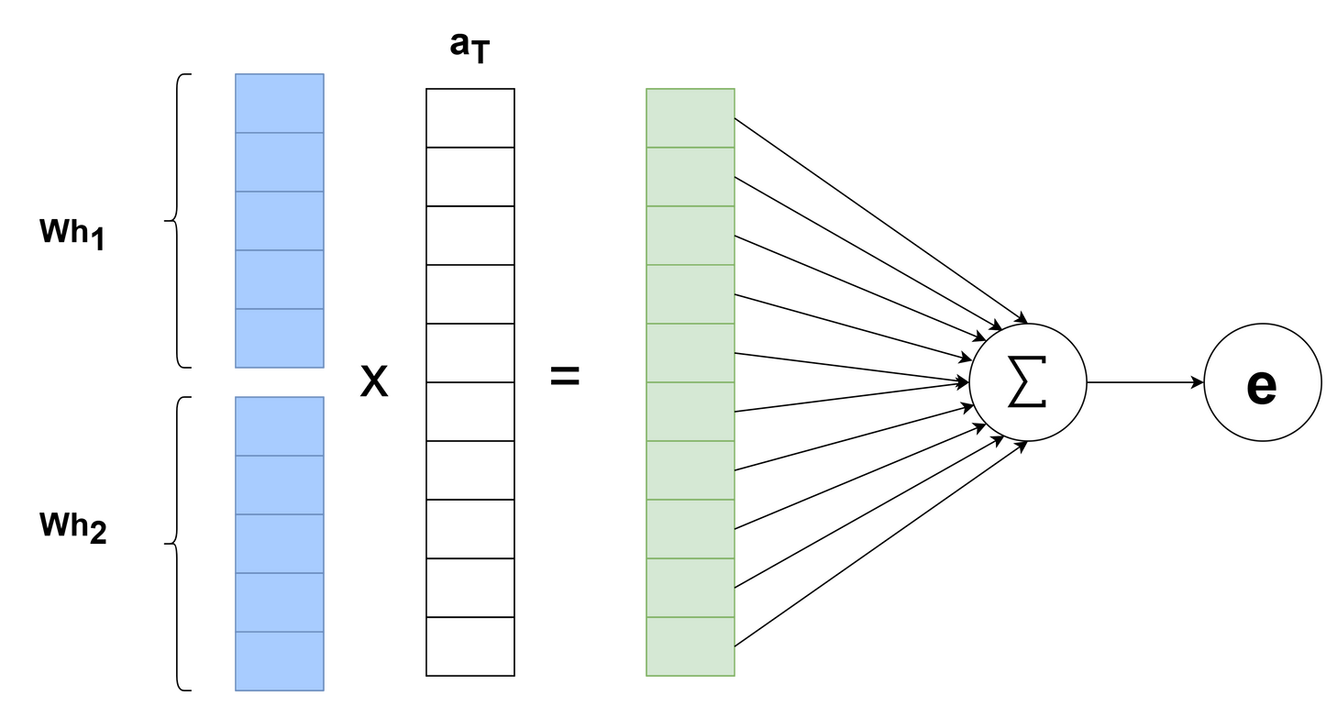
Graph Attention Network
Ho Chi Minh University of Technology
Faculty of Computer Science and Engineering
Computer Engineering Project | 2024
Attention coefficient
9
Notes:
attention means to define the importance of the connected node in the graph.
there will be learnable attention weight, and we have to concatenate z values of 2 connected node to multiply them.

Slide 11
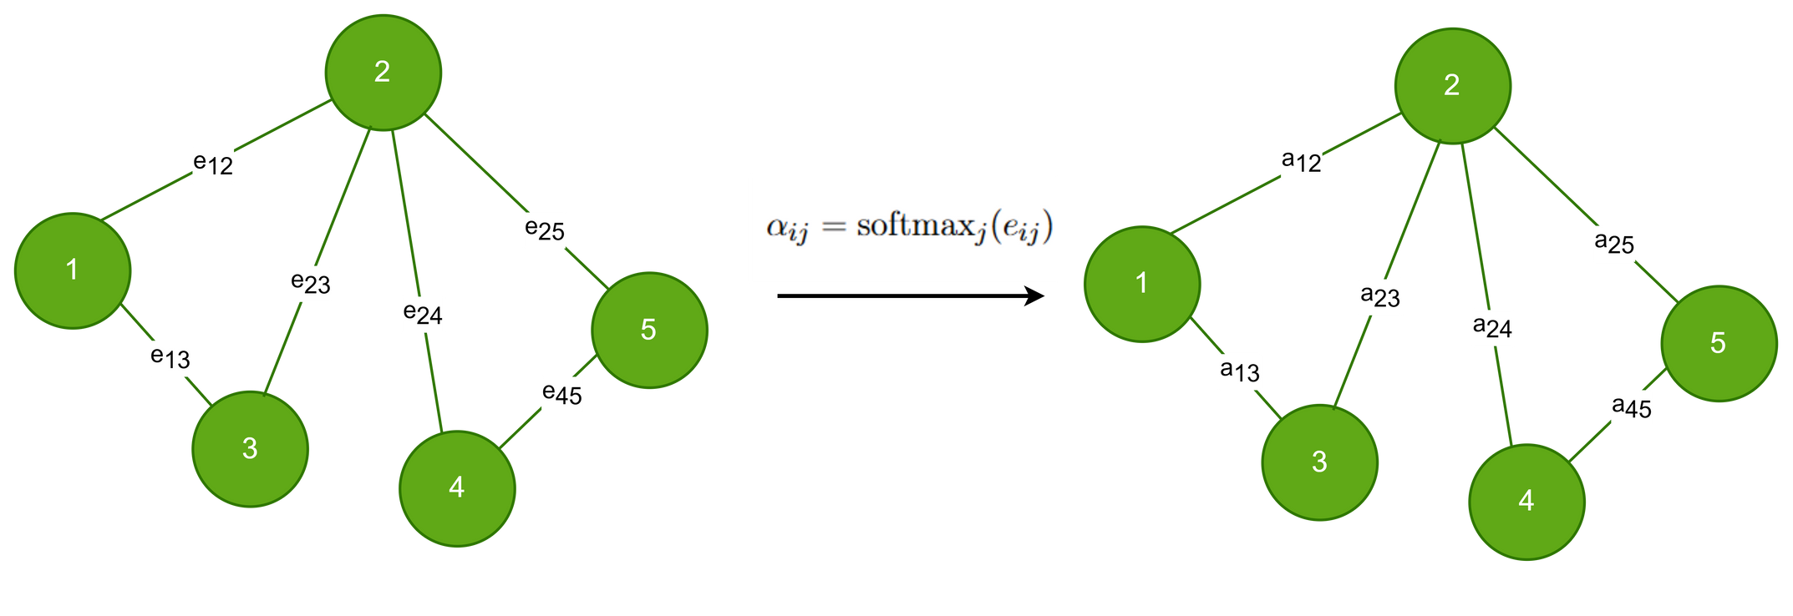
Graph Attention Network
Ho Chi Minh University of Technology
Faculty of Computer Science and Engineering
Computer Engineering Project | 2024
Softmax
10
Notes:
Softmax normalizes the result into a probability distribution.
The reason of softmax is to classify, score the importance of edges
in this case
attention coefficient in each edge of neighboring nodes will be normalized.

Slide 12
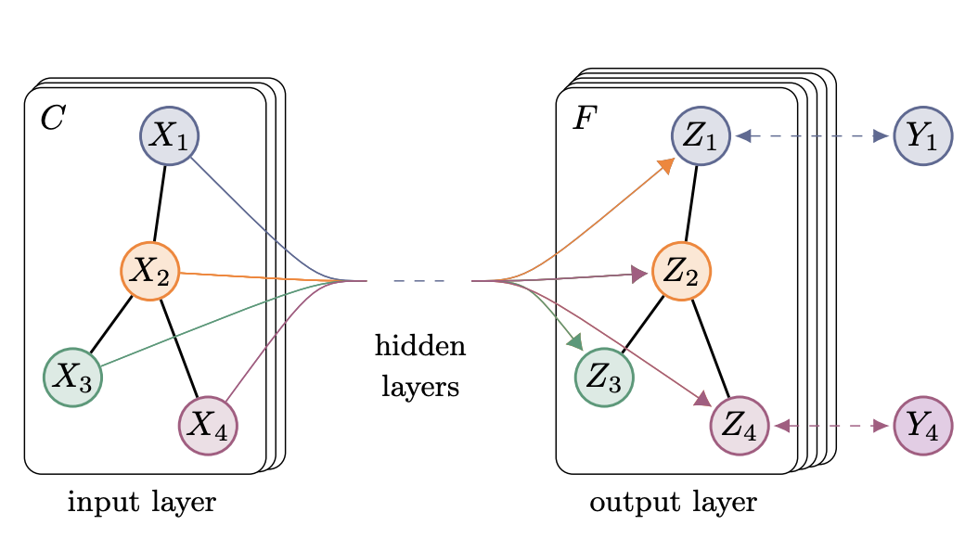
Graph Attention Network
Ho Chi Minh University of Technology
Faculty of Computer Science and Engineering
Computer Engineering Project | 2024
Aggregation
11
Notes:
Final calculation of a GAT layer is aggregating all the previous calculations to return the output of the layer.
GAT layer result will be the sum of Weighted features, combine with attention coefficient.
To control output range, there will an activation function applied to the aggregated result.

Slide 13
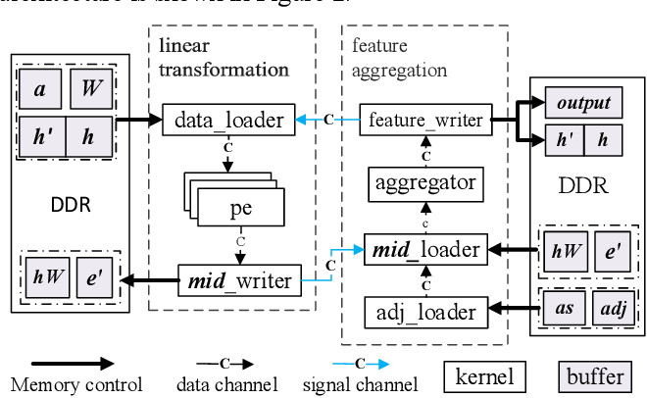
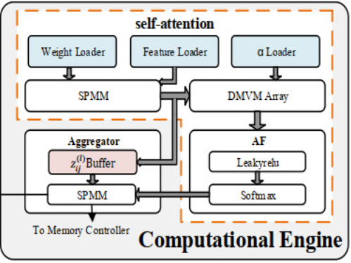
Related Work
Ho Chi Minh University of Technology
Faculty of Computer Science and Engineering
Computer Engineering Project | 2024
S-GAT: (W. Yan, W. Tong and X. Zhi)
Model compression, feature quantization, shift-based multiplication.
Performance: 593x CPU, 7.34x Nvdia Tesla V100
SH-GAT: (Wang. et.al)
Split weights, softmax approximation, load-balanced SPMM, pre-fetching to address memory irregularities.
Performance: 3283x CPU. 13x GPU
12

Slide 14
Methodological
Approach
03
13

Slide 15
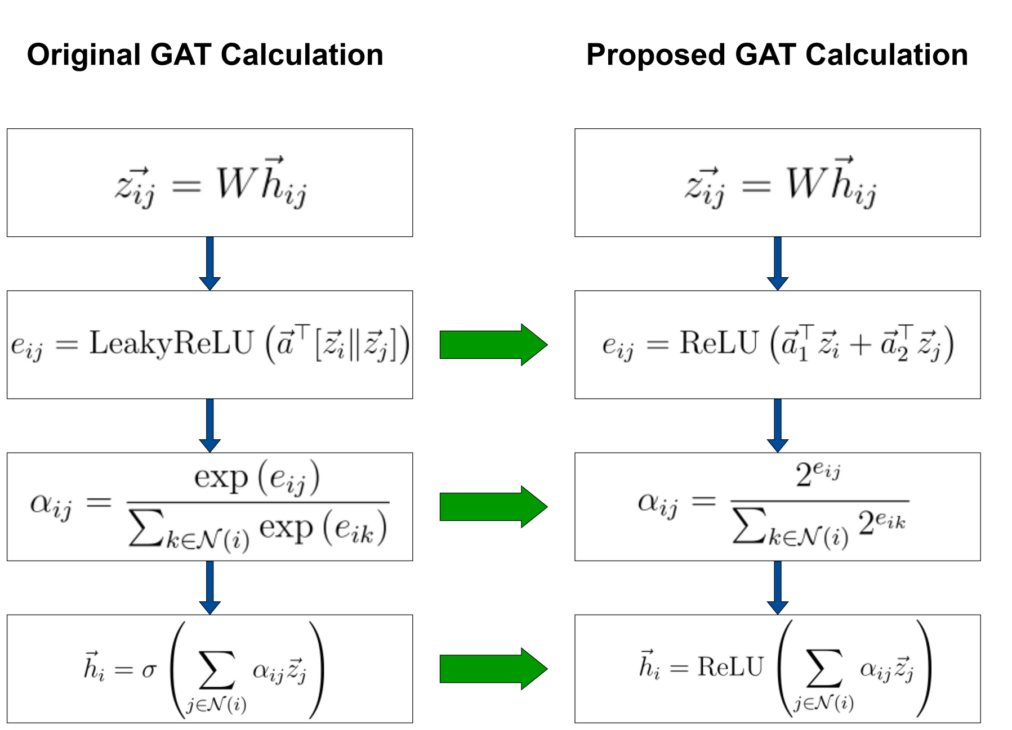
Algorithm Optimization
Ho Chi Minh University of Technology
Faculty of Computer Science and Engineering
Computer Engineering Project | 2024
14
Notes:
To implement in hardware, We need to adjust somecalculations to optimize resource and calculation processes.
All Activation functions should change to ReLU in order to avoid negative values.
the concatenation in attention coefficient needs to change to the sum of splitted attention weights. to avoid repetitive multiplication of the z and a.
exponential with base e will be changed to base 2 to gain benefits from shift bit operation in hardware.
Hence, all this modification have to be validate and evaluate system accuracy.

Slide 16
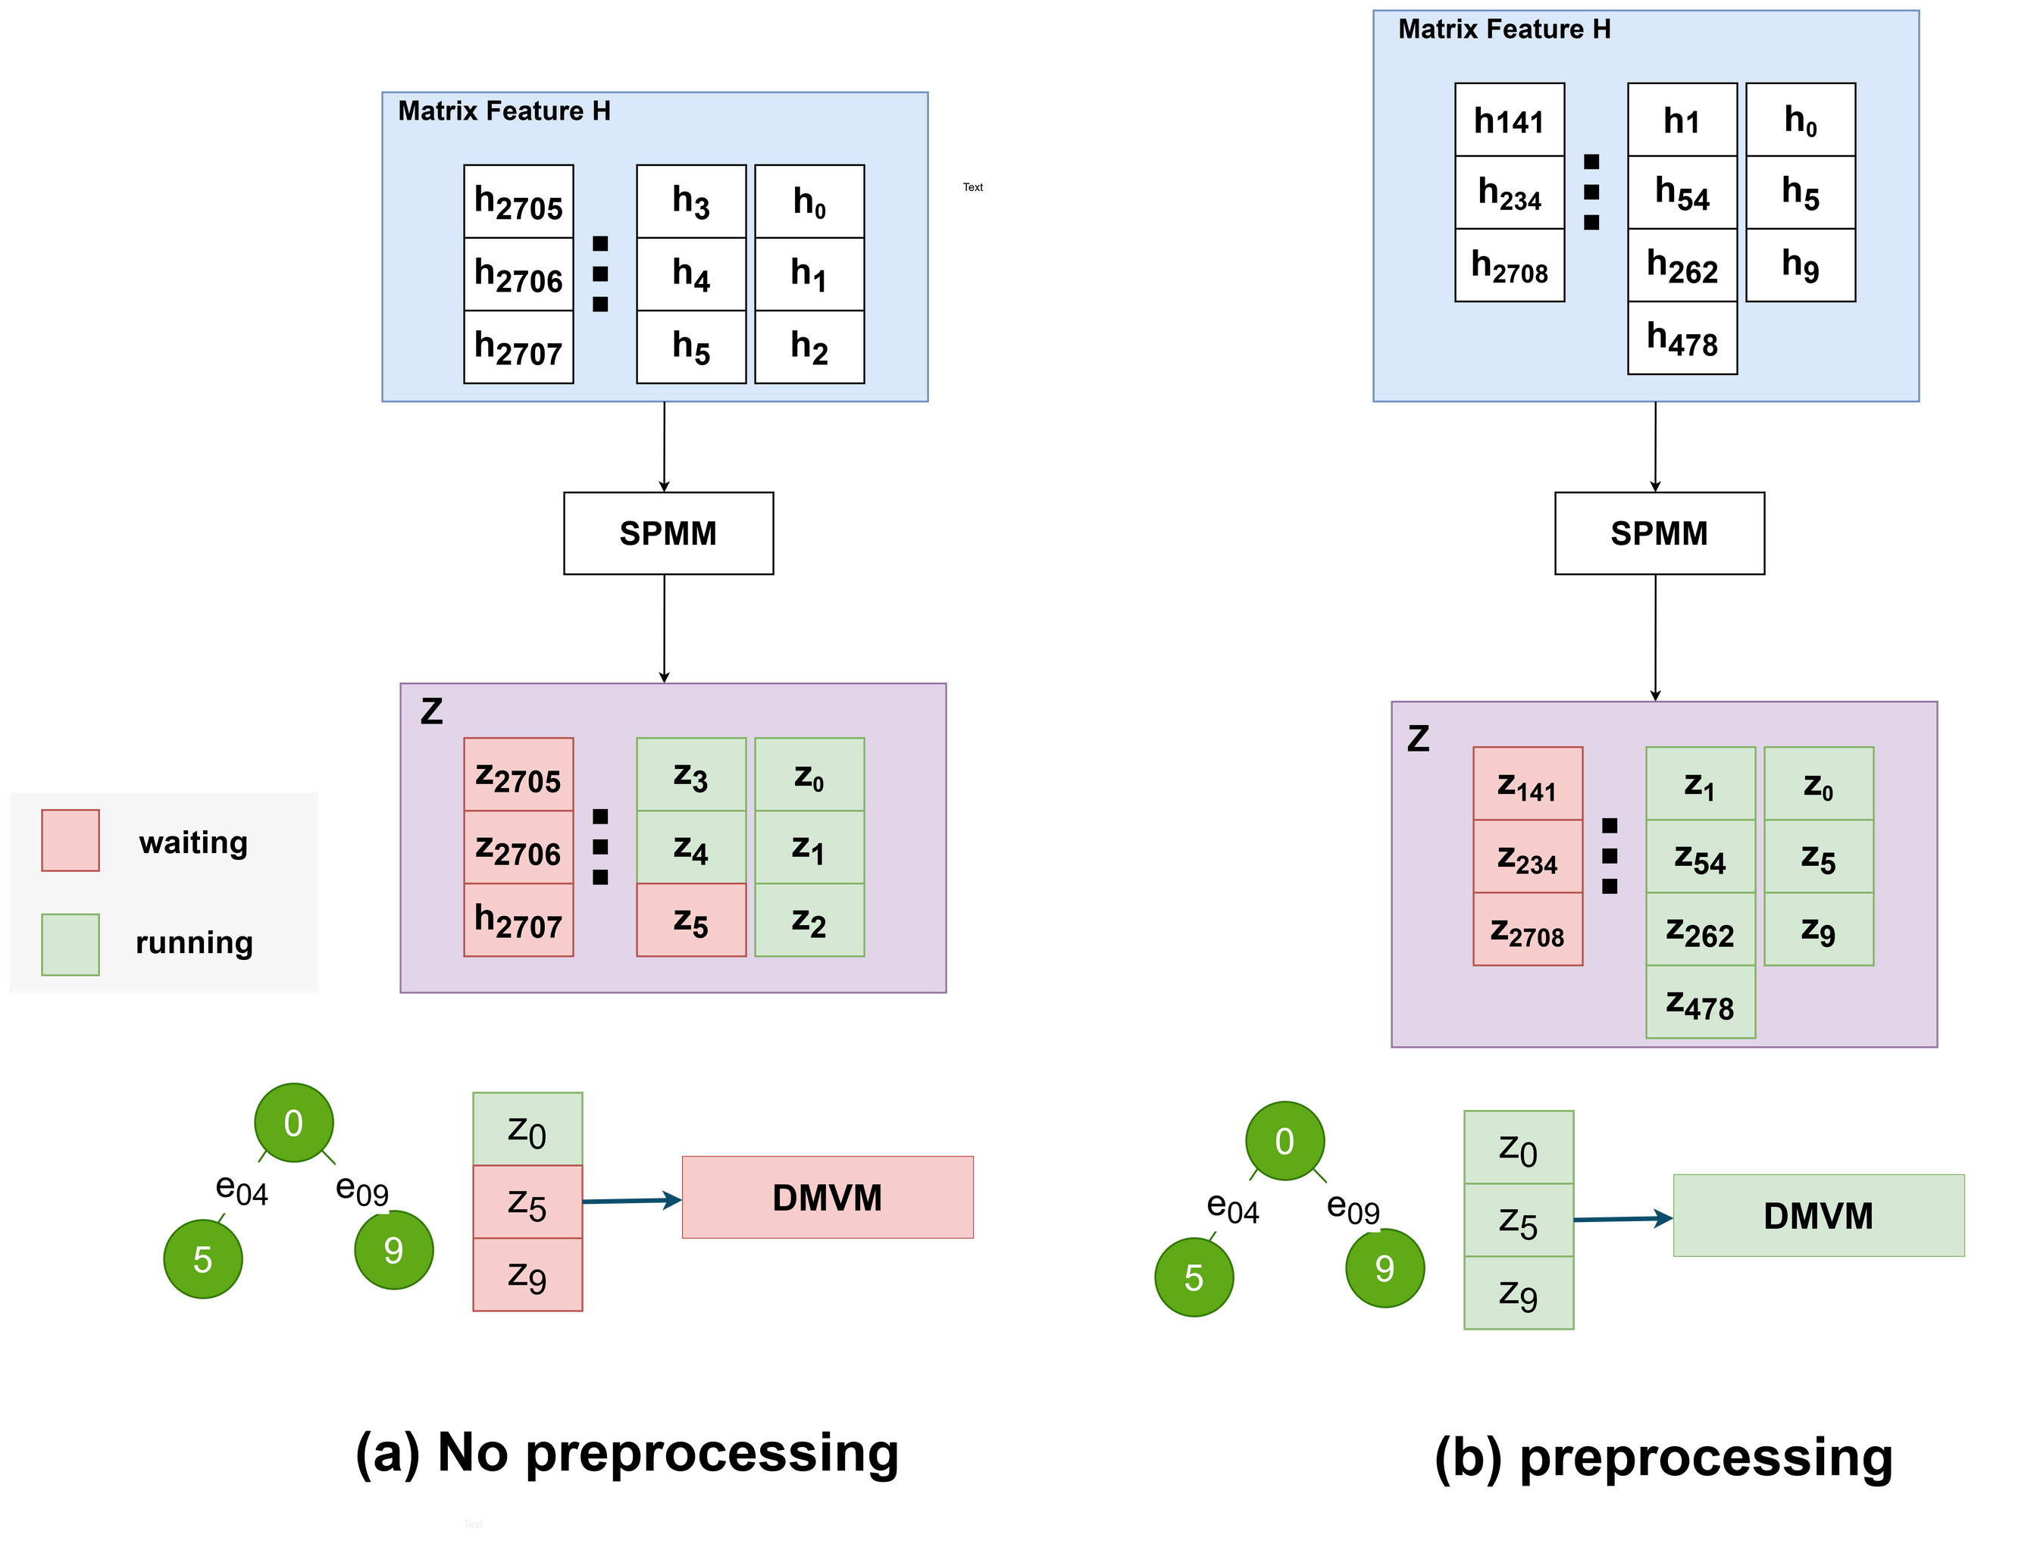
Data pre-processing
Ho Chi Minh University of Technology
Faculty of Computer Science and Engineering
Computer Engineering Project | 2024
Pipeline stalls occur due to unorganized data flow through computational modules.
==> Group source node and neighboring nodes into a subgraph to streamline data flow and prevent stalls.
15
Notes:
Unstructured data of input feature matrix will result in unstructured data through some calculation module.
Hence, some processes have to wait for values to finish computing for a long time,may cause some pipeline stalls issue.
we propose to organize data in the beginning before transfer to hardware implementation. therefore all related node can be grouped together and finish calculating at the same time in each module block.

Slide 17
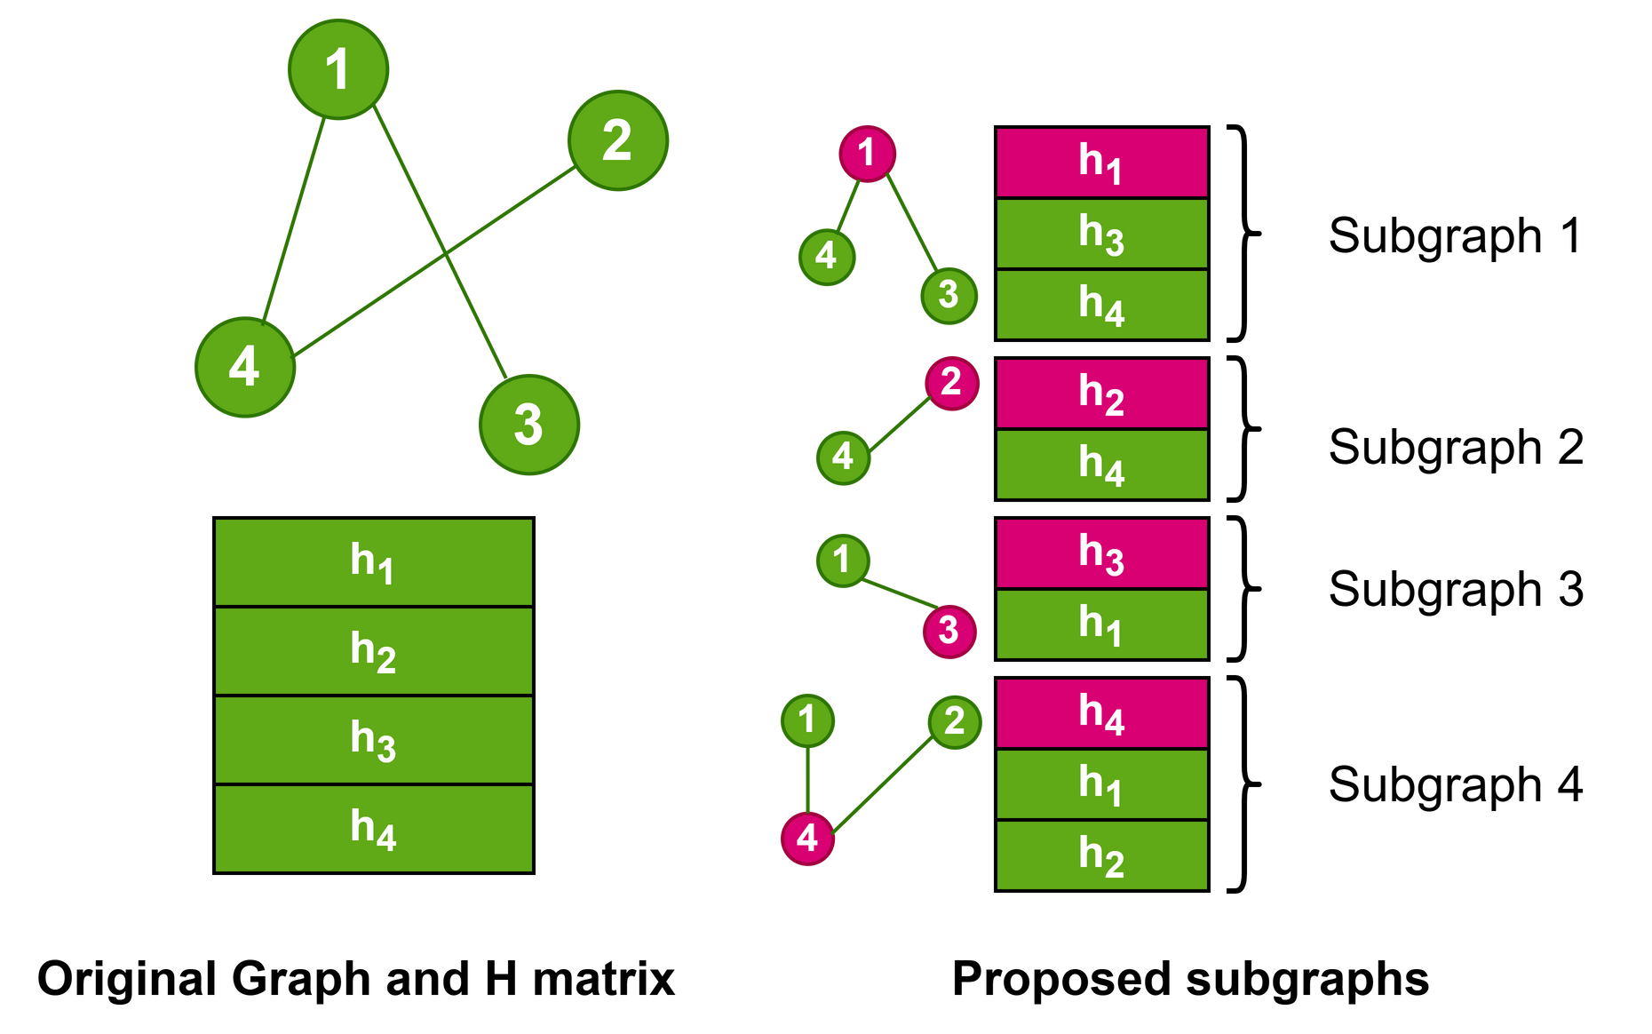
Data pre-processing
Ho Chi Minh University of Technology
Faculty of Computer Science and Engineering
Computer Engineering Project | 2024
A 4-node graph can represent as 4 subgraphs.
Source node: header of each subgraph.
Neighbor node: node adjacent to source node.
16
Notes:
We proposed to group connected node into subgraphs, with source node and the neighboring node.
in this example, 4 node graph can represent as 4 subgraphs.
source node: will be at head.
while other connected node is followed.

Slide 18
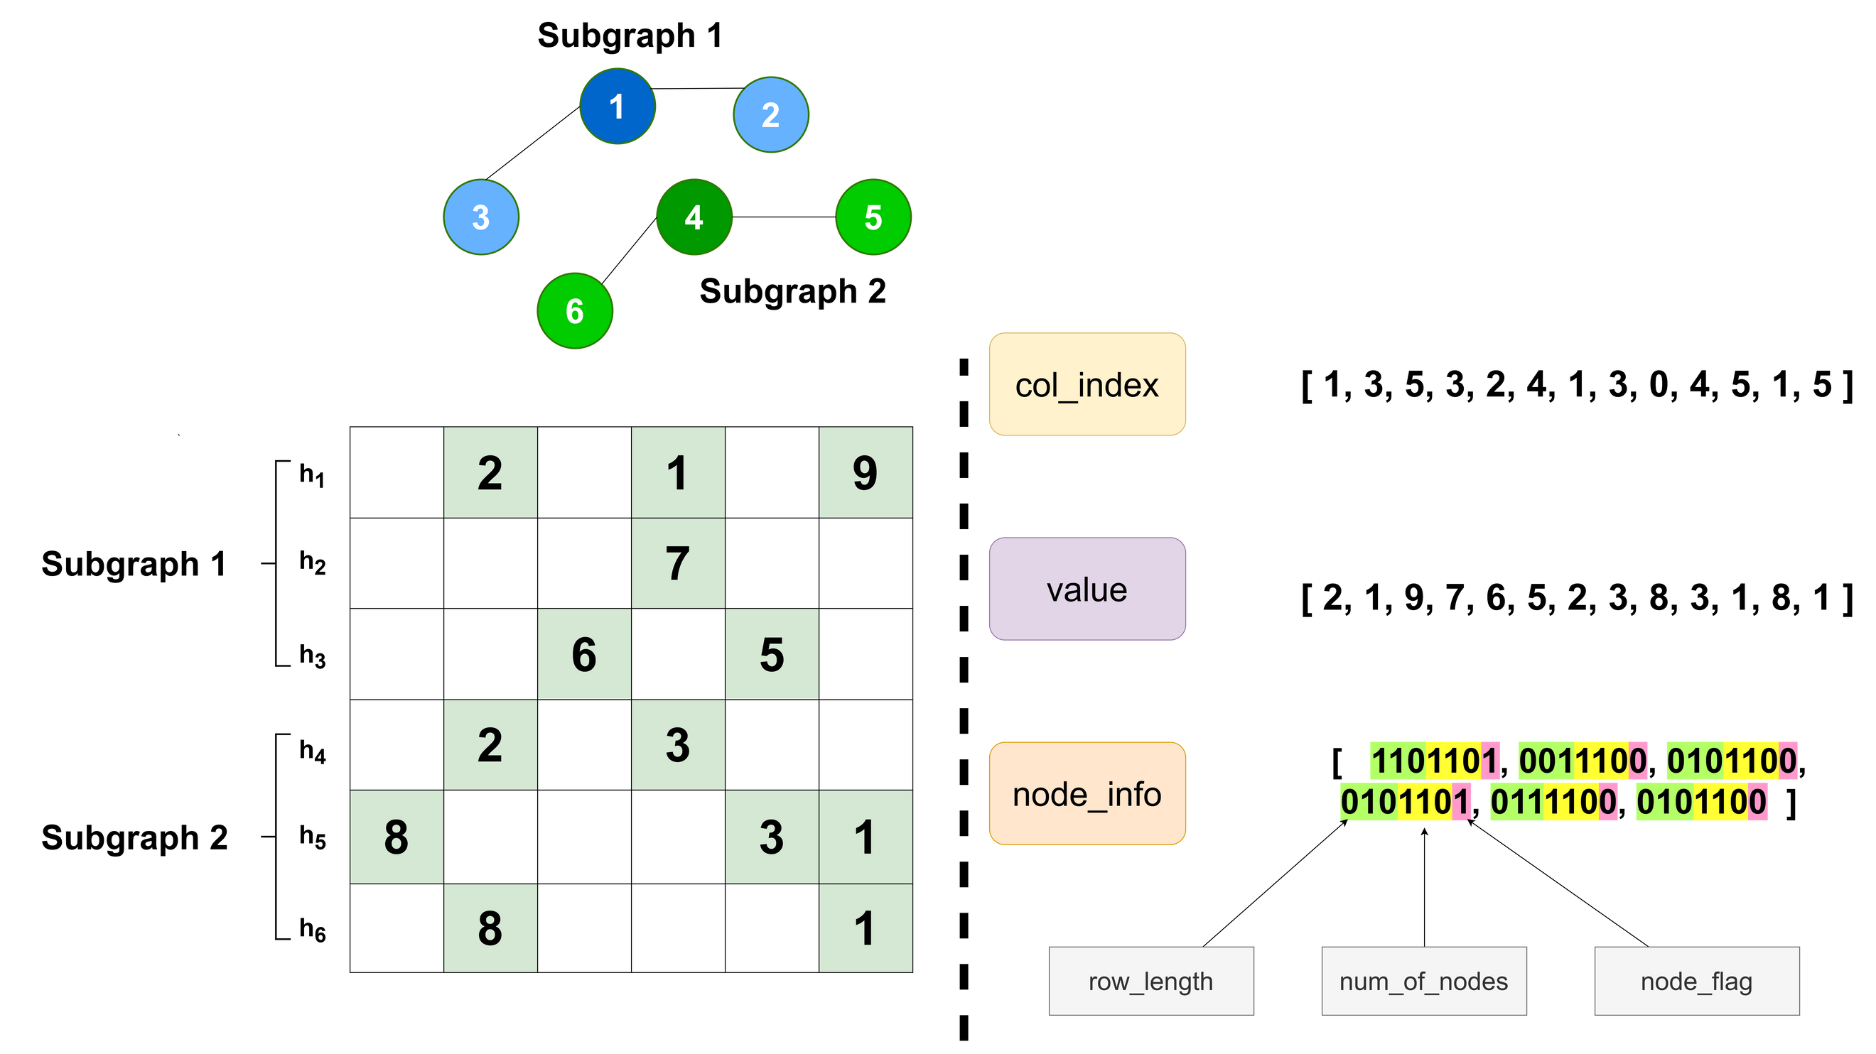
GCSR Format
Ho Chi Minh University of Technology
Faculty of Computer Science and Engineering
Computer Engineering Project | 2024
GCSR stands for Graph Compressed Sparse Row.
Collect information of index and value, compressed it into 3 components.
Organized by subgraphs.
17
Notes:
Graph Compressed Sparse Row
We introduce a new format for graph representation, by collect information of non-zero value in the feature subgraphs.
info can be extract in 3 array:
col index column index of value
value
node_info: comprise of row length (how many non-zero value in subgraph), num_of_nodes in subgraphs, node_flag indicate source node.

Slide 19
Overall Architecture
04
18

Slide 20
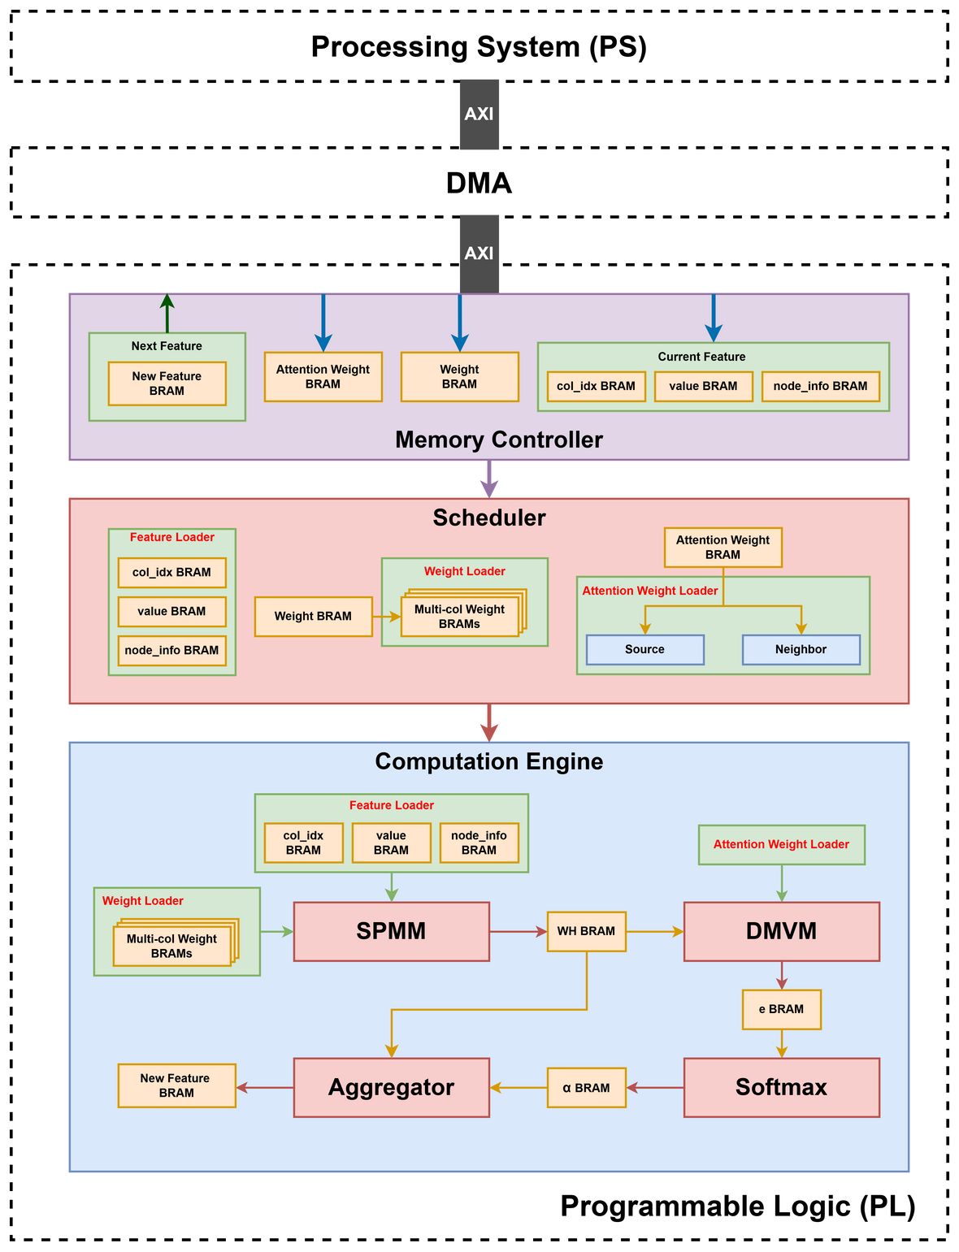
General Architecture
Ho Chi Minh University of Technology
Faculty of Computer Science and Engineering
Computer Engineering Project | 2024
PS is responsible for running software application (training GAT model and transferring input data).
PL is responsible for operating GAT algorithm.
Memory Controller (6 BRAMs).
Scheduler (3 Loaders).
SPMM (Sparse Matrix Multiplication).
DMVM (Dense Matrix Vector Multiplication).
Softmax.
Aggregator.
19

Slide 21
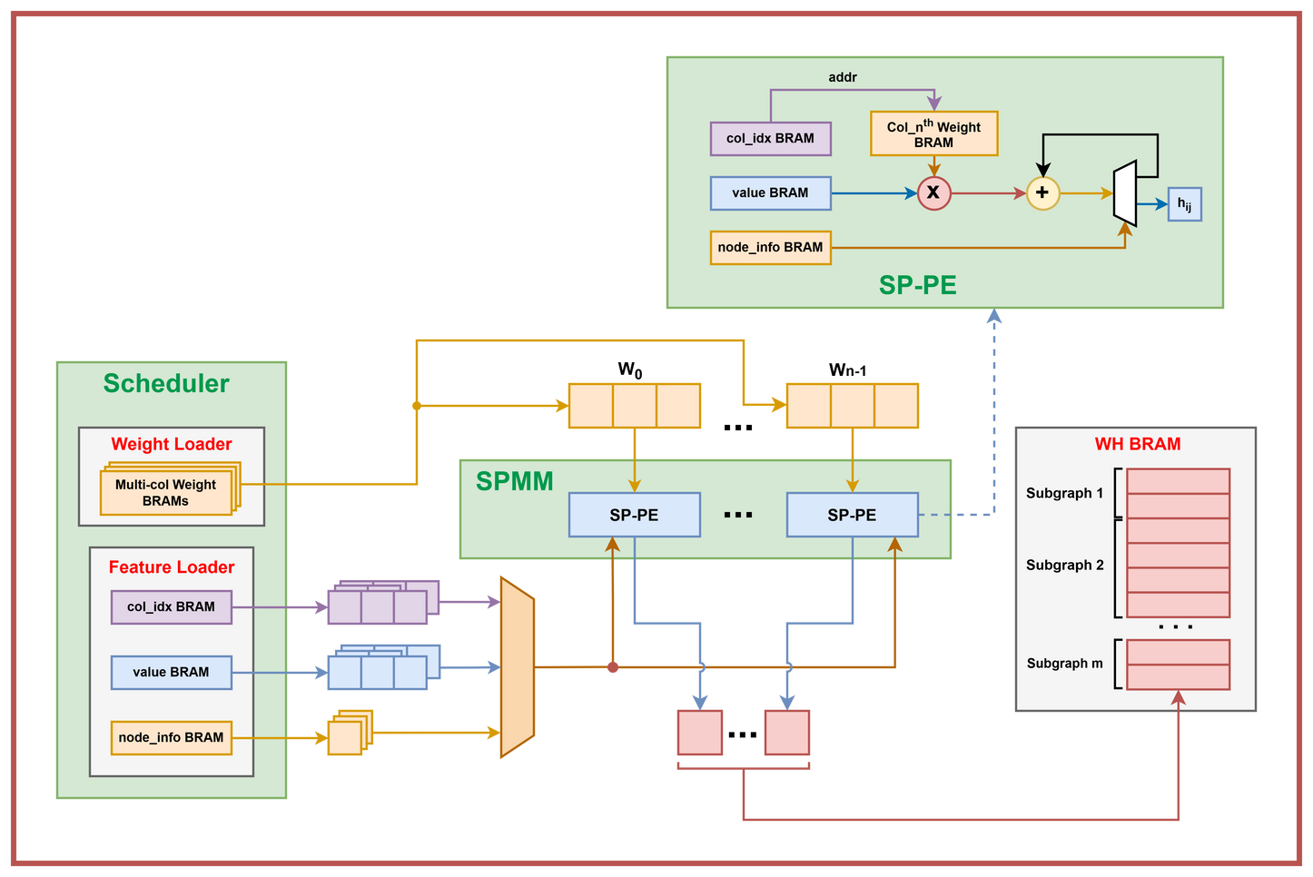
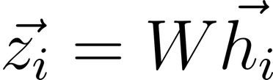
SPMM/SP-PE
(Sparse Matrix Vector Multiplication/Sparse Processing Element)
Ho Chi Minh University of Technology
Faculty of Computer Science and Engineering
Computer Engineering Project | 2024
Each SP-PE contains a column-specific Weight BRAM.
col_idx is used as read address to retrieve the corresponding weight value from BRAM.
When the number of non-zero feature values reaches row_length, pe_ready_o will be asserted.
20

Slide 22
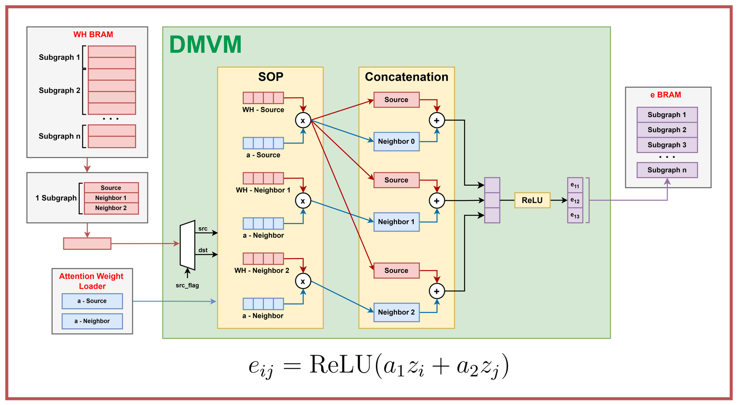
DMVM
(Dense Matrix Vector Multiplication)
Ho Chi Minh University of Technology
Faculty of Computer Science and Engineering
Computer Engineering Project | 2024
Each WH entry is multiplied with either a_source or a_neighbor based on src_flag.
The result is then concatenated with the source node's product.
Finally, it passes through the ReLU function to retrieve Attention Cofficient e.
21

Slide 23
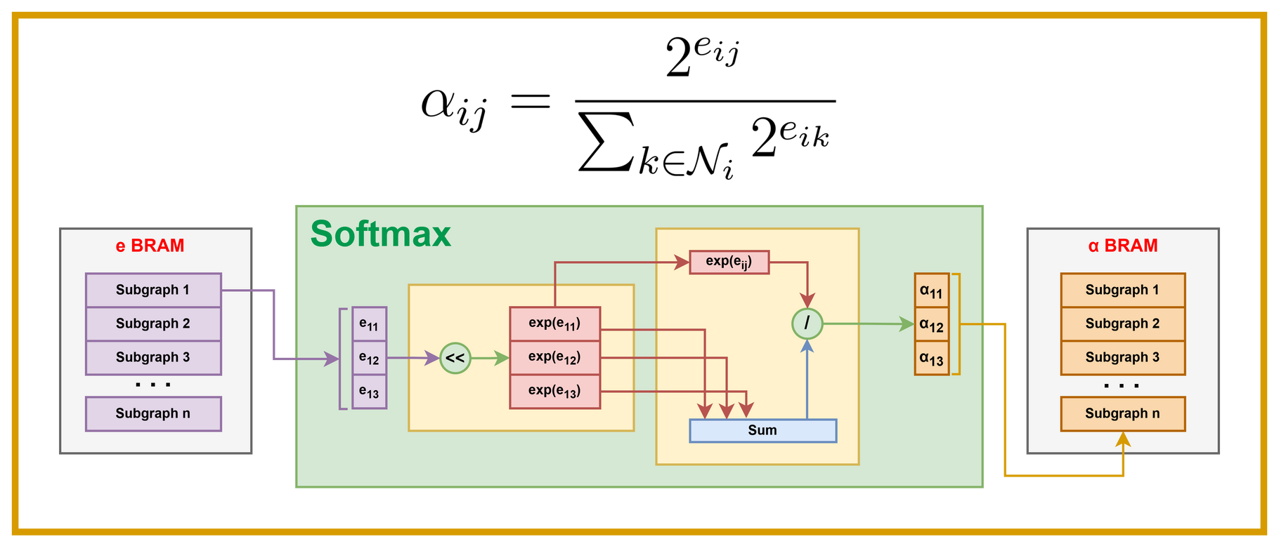
Softmax
Ho Chi Minh University of Technology
Faculty of Computer Science and Engineering
Computer Engineering Project | 2024
Each entry from e BRAM contains attention coefficients of a subgraph.
After calculating the base-2 exponentials for each coefficient, their sum is computed sequentially.
Finally, each base-2 exponential coefficient is divided by the sum to obtain the normalized coefficient.
22

Slide 24
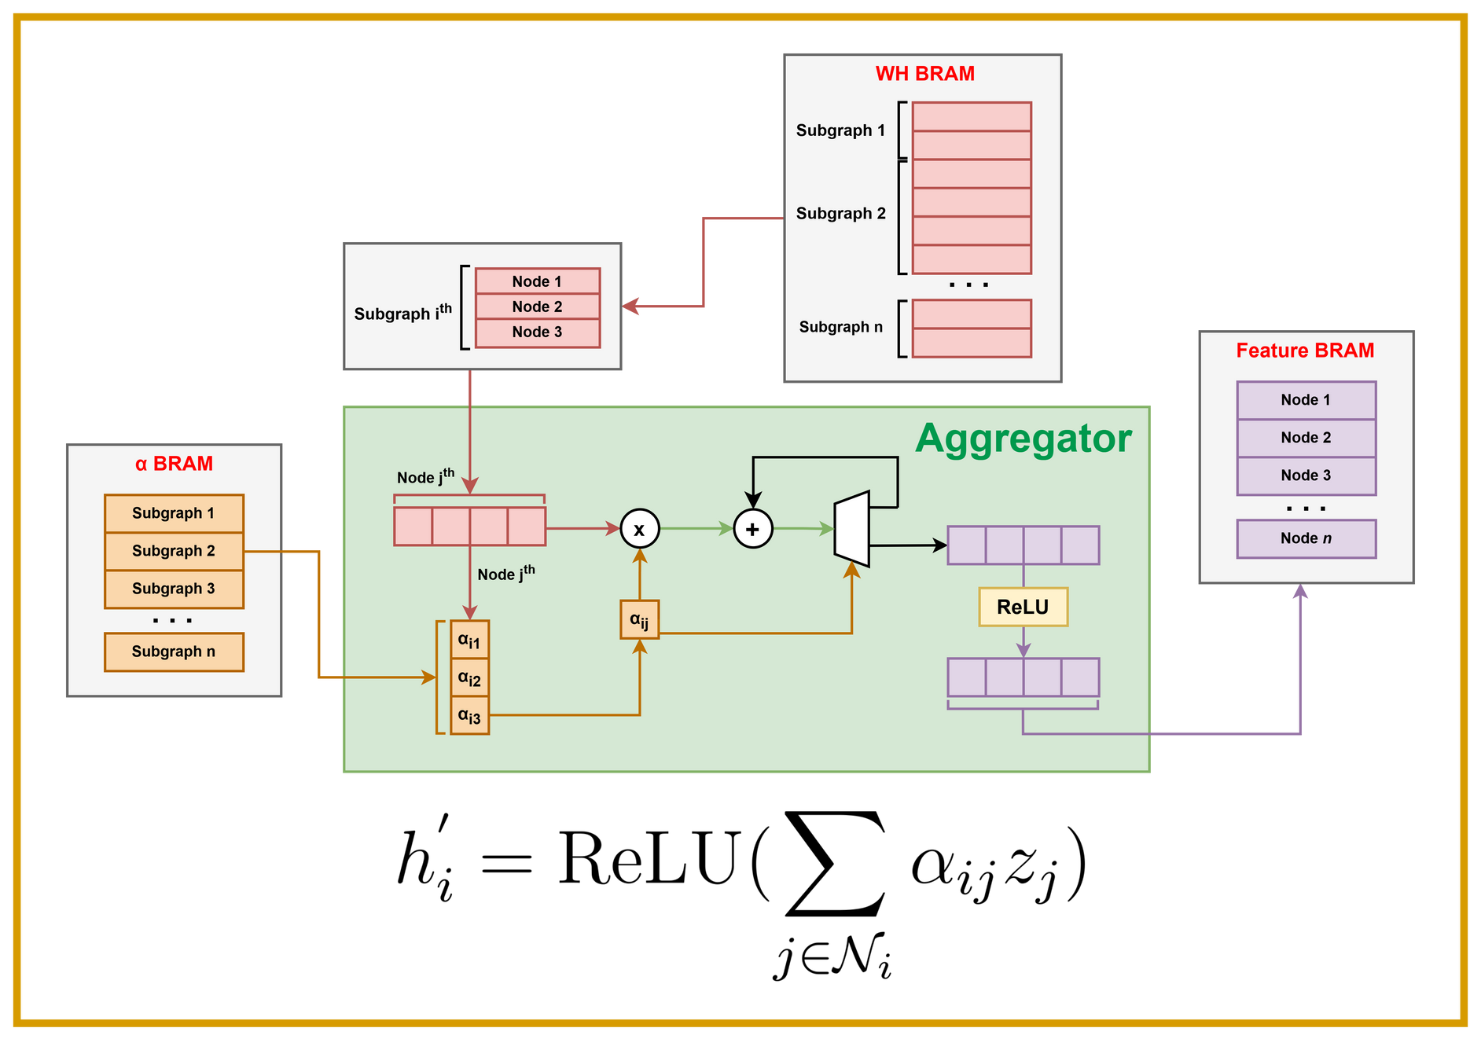
Aggregator
Ho Chi Minh University of Technology
Faculty of Computer Science and Engineering
Computer Engineering Project | 2024
Each vector from WH BRAM is multiplied with corresponding normalized coefficient from α BRAM.
The results are accumulated until all nodes in the subgraph are processed.
Finally, the accumulated values pass through the ReLU function to produce the feature vector for the next layer.
23

Slide 25
05
Implementation
24

Slide 26
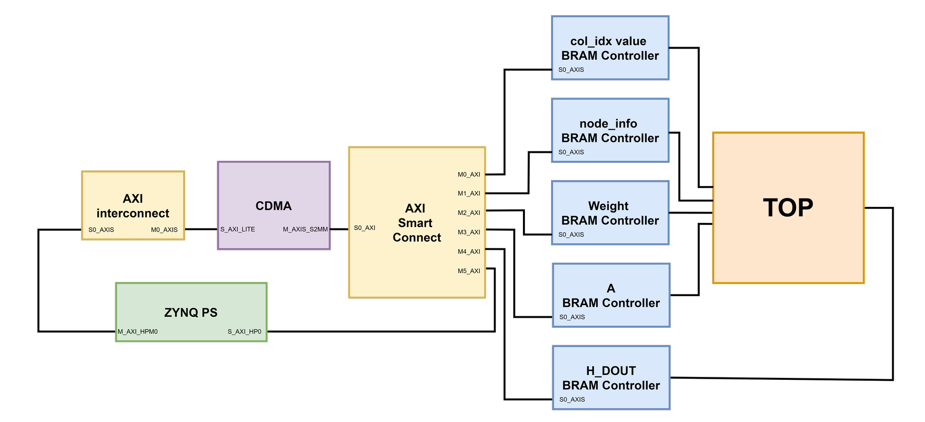
System Implementation
Ho Chi Minh University of Technology
Faculty of Computer Science and Engineering
Computer Engineering Project | 2024
System Block Design (Vivado)
25

Slide 27
06
Results
26

Slide 28
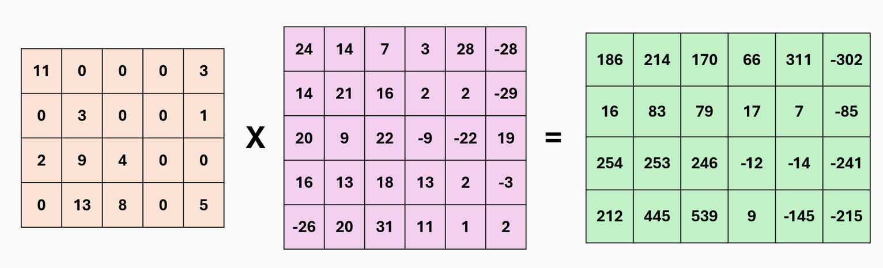
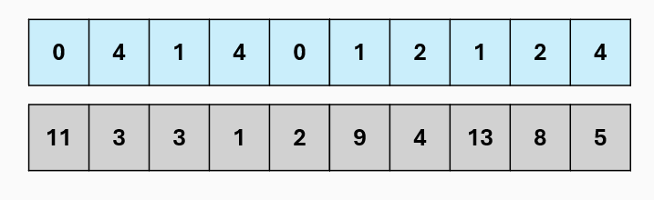
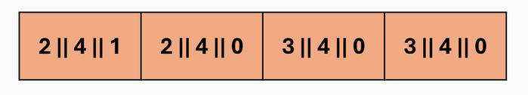
SPMM Simulation
Ho Chi Minh University of Technology
Faculty of Computer Science and Engineering
Computer Engineering Project | 2024
Feature (4x5)
Weight (5x6)
WH (4x6)
col_idx
value
node_info
27

Slide 29
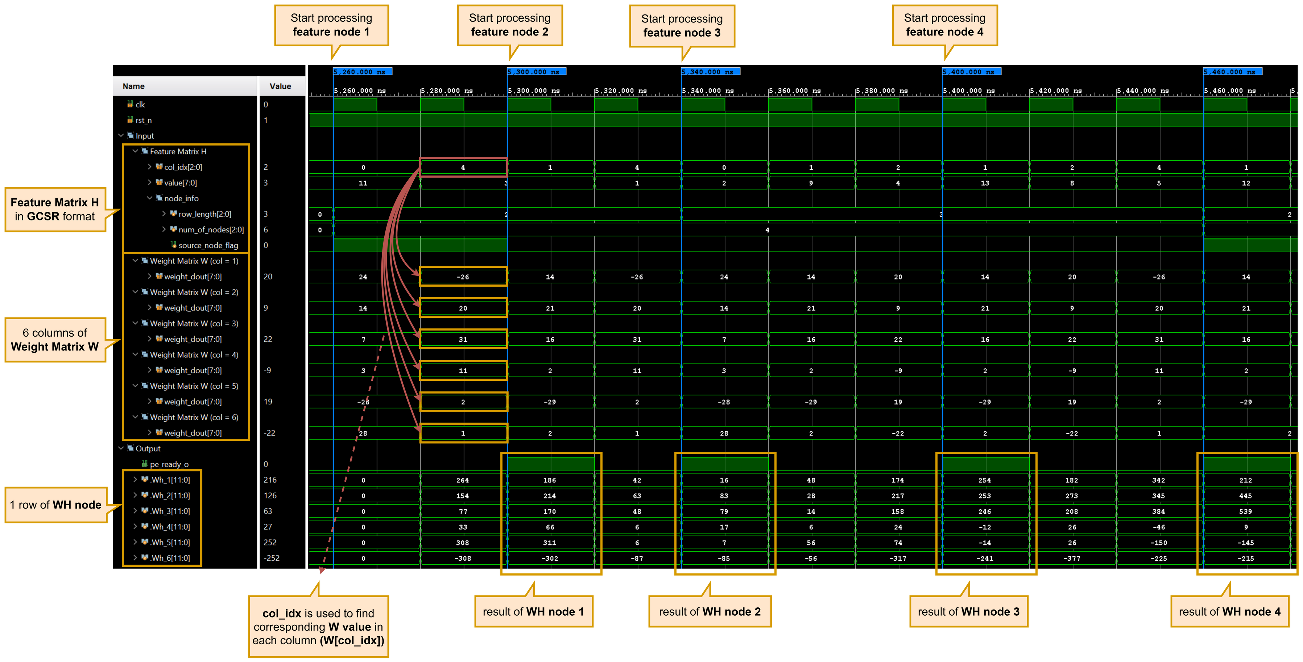
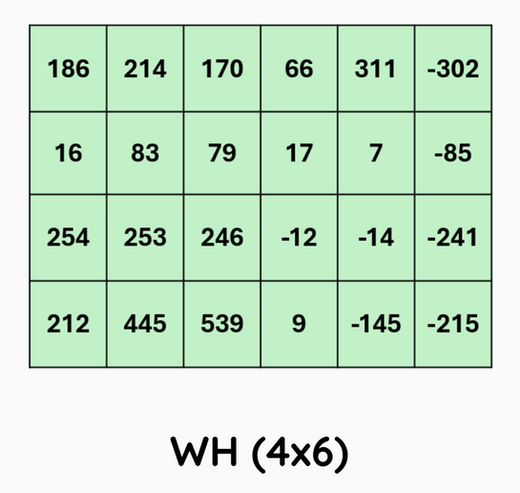
SPMM Simulation
Ho Chi Minh University of Technology
Faculty of Computer Science and Engineering
Computer Engineering Project | 2024
28

Slide 30
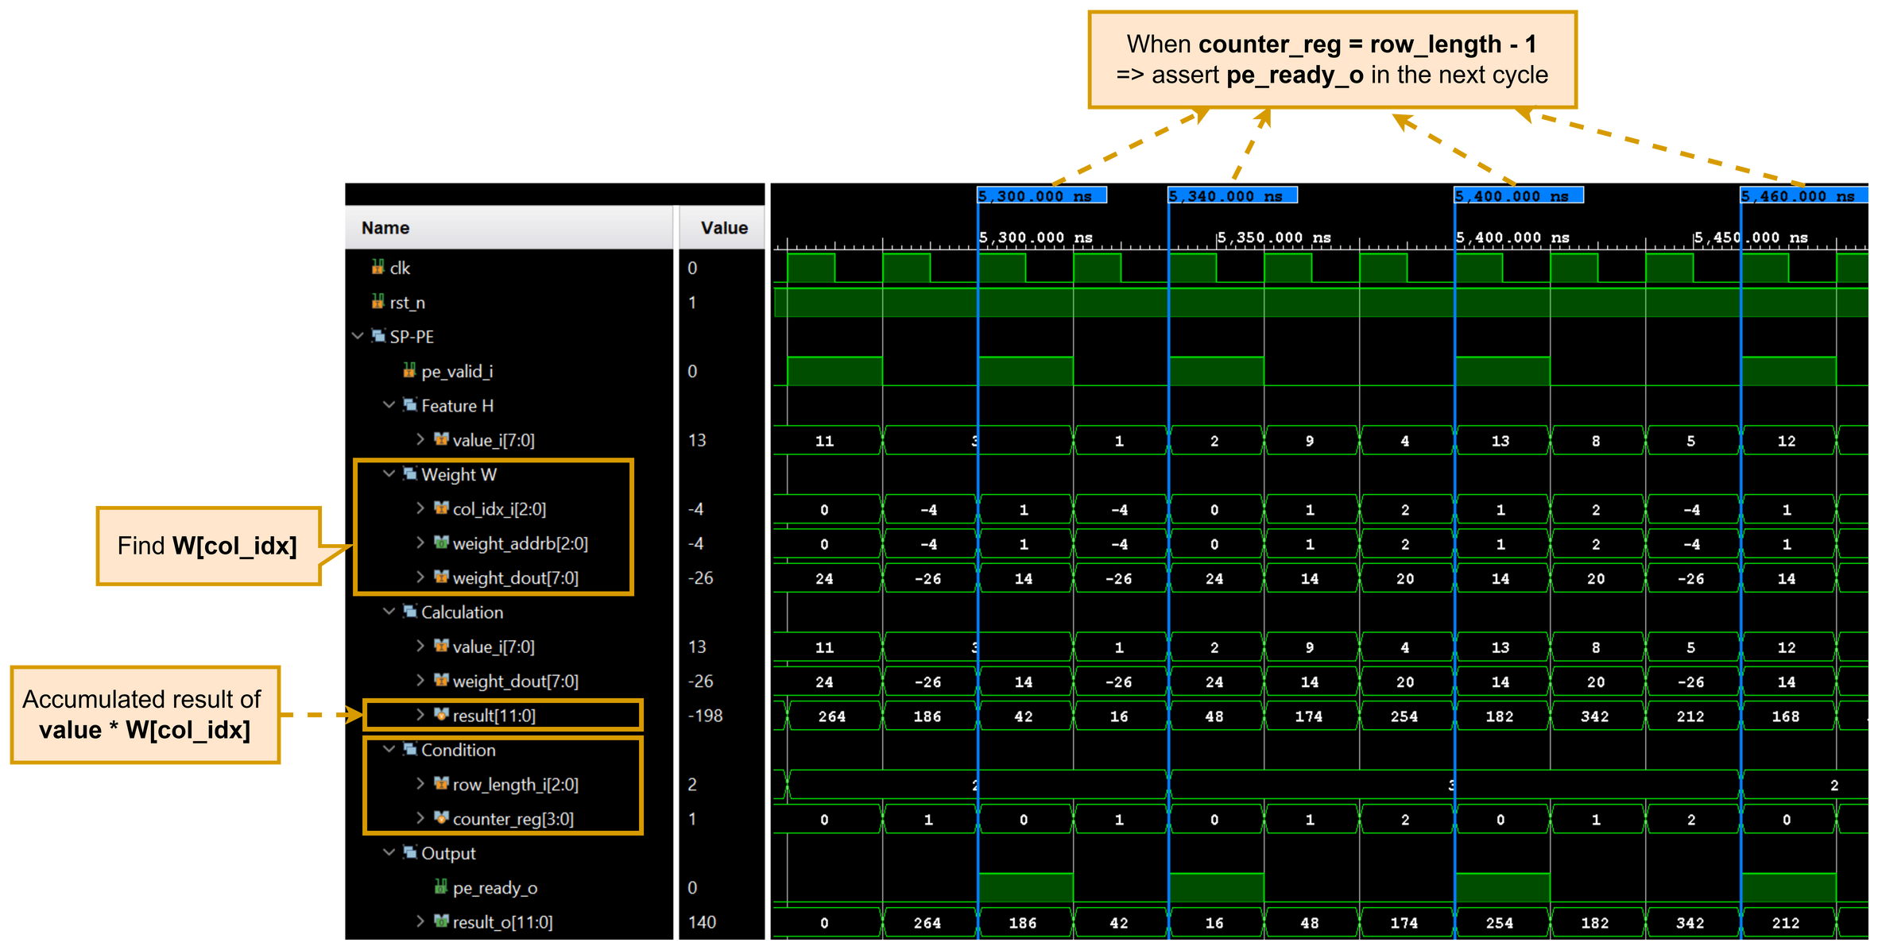
SPMM Simulation
Ho Chi Minh University of Technology
Faculty of Computer Science and Engineering
Computer Engineering Project | 2024
Calculation operation in one SP-PE module
29

Slide 31
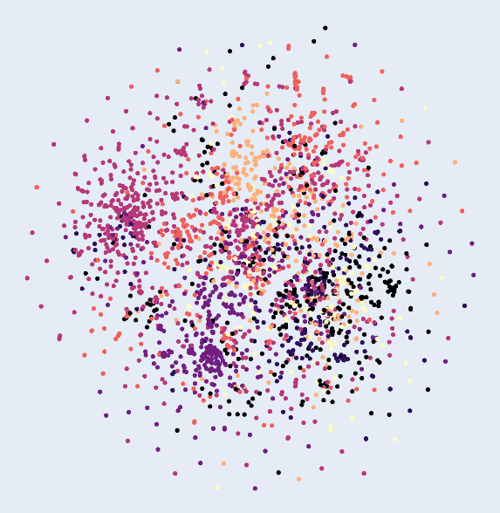
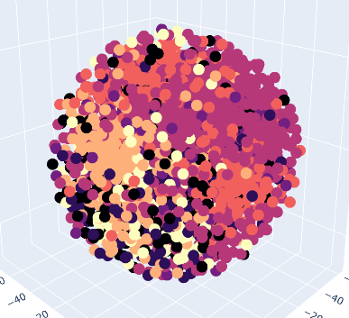
Model Training
Ho Chi Minh University of Technology
Faculty of Computer Science and Engineering
Computer Engineering Project | 2024
Visualize Cora Dataset (Without Training)
2-D Visualization
3-D Visualization
30

Slide 32
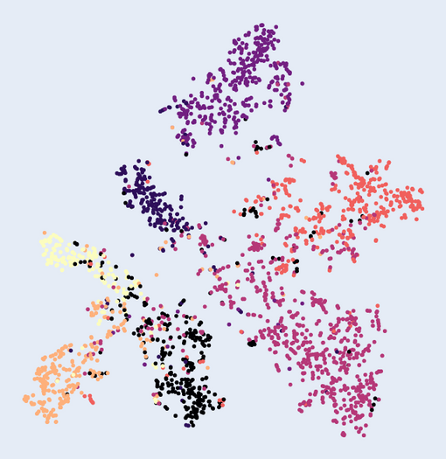
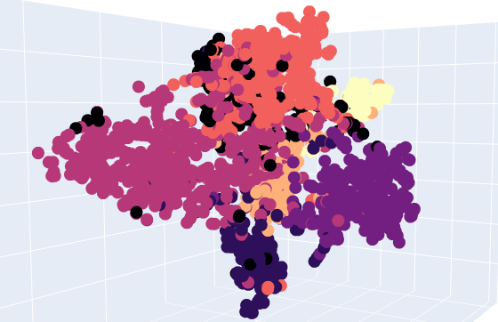
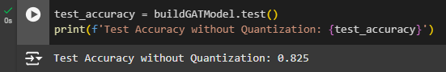
Model Training
Ho Chi Minh University of Technology
Faculty of Computer Science and Engineering
Computer Engineering Project | 2024
Visualization (Training GAT Model + Without Quantization)
82.5%
Accuracy
3-D Visualization
2-D Visualization
31

Slide 33
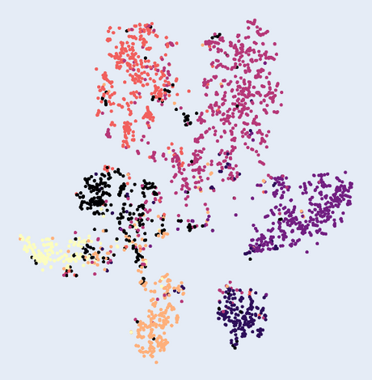
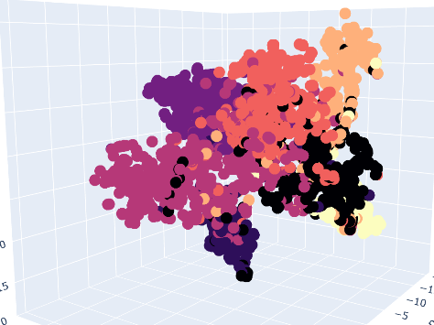
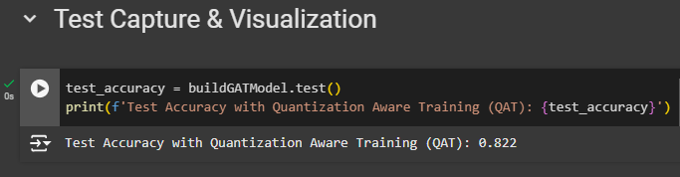
Model Training
Ho Chi Minh University of Technology
Faculty of Computer Science and Engineering
Computer Engineering Project | 2024
Visualization (Training GAT Model + Quantization)
82.2%
Accuracy
3-D Visualization
2-D Visualization
32

Slide 34
Future Plan
33

Slide 35

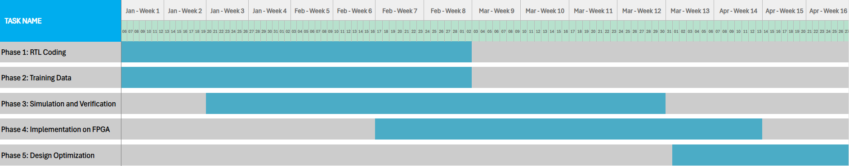
Future Plan
Ho Chi Minh University of Technology
Faculty of Computer Science and Engineering
Computer Engineering Project | 2024
Proposed Timeline And Goals
34

Slide 36
Thank you for your Attention
35

Slide 37
System Accuracy
Ho Chi Minh University of Technology
Faculty of Computer Science and Engineering
Computer Engineering Project | 2024
Visualization (Full Flow Simulation On Software)
82.2%
Accuracy
3-D Visualization
2-D Visualization
36

Slide 38
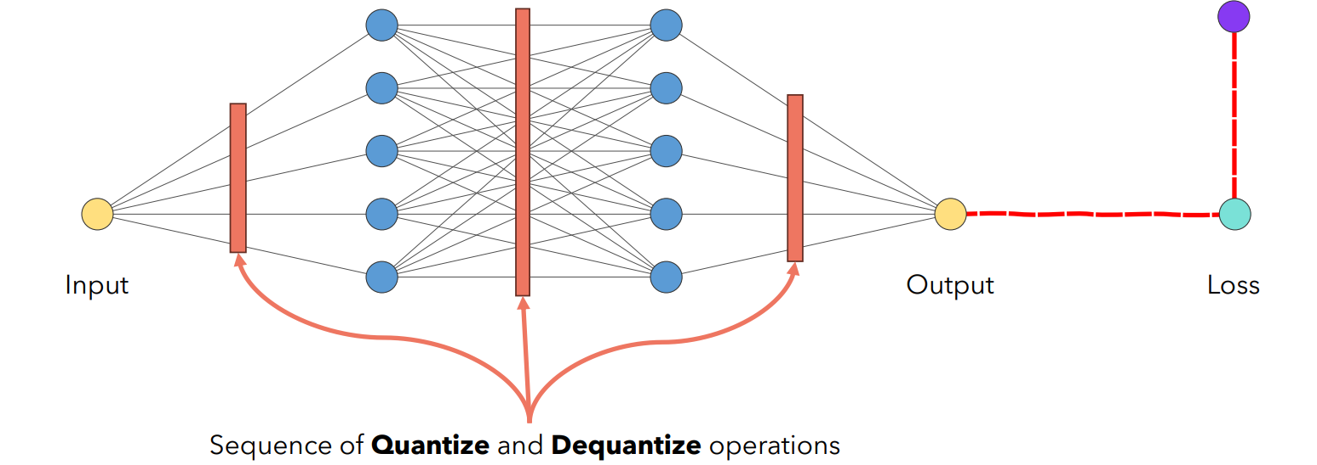
Quantization Process
Convert parameters from Float32 to Int8
Apply Quantization Aware Training (QAT) technique
Detailed Flow
37

Slide 39
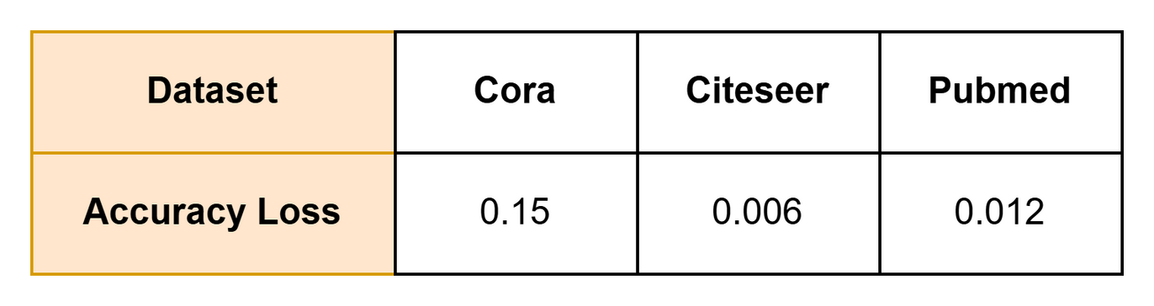
Softmax Accuracy Loss
Ho Chi Minh University of Technology
Faculty of Computer Science and Engineering
Computer Engineering Project | 2024
Accuracy loss across datasets
38

Slide 40
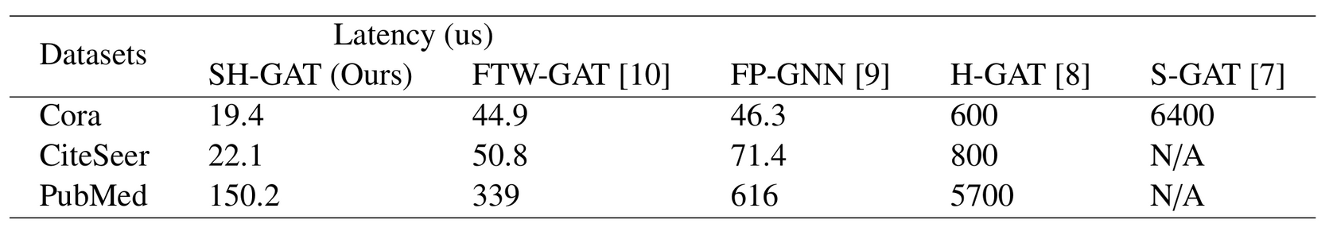
Latency Comparison
Ho Chi Minh University of Technology
Faculty of Computer Science and Engineering
Computer Engineering Project | 2024
Comparison with FPGA-based accelerators on latency
39

Slide 41
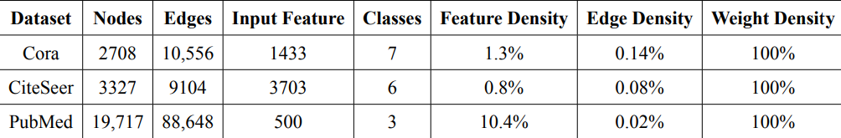
GAT With Dataset
Cora (Previous Slide)
CiteSeer
PubMed
Dataset information with Nodes, Edges and Features
40

